Slide 2

Implementation of Encryption & Decryption Algorithm
MINOR-1
Prabal Bansal Prithvi Chauhan Rohit Singh Chauhan Sanjay Singh Chauhan
500068861 500068398 500069845 500067645
Under the guidance of Mr.Amrendra Nath Tripathi

Slide 3
ABSTRACT
Having prior knowledge about security is helpful to believe some company for security . Our project i:e Implementation of Encryption and decryption algorithms helps user to get to know how much their data is secured . Here we have implemented symmetric algorithms like DES and many less secure primitive encryption and decryption algorithms. And for asymmetric we have implemented RSA. In Client-Server fashion to get user a real time experience.
Keywords: Security, Socket , Key , Cipher text.

Slide 4
INTRODUCTION
Our goal is to implement the working of encryption algorithms by encrypting files and sharing it through socket programming.
By implementing the encryption algorithms we have achieved secure transfer of messages from client to server. We have achieved it by using a very complex encryption algorithm which is RSA(Rivest, Shamir and Adelman) ,DES algorithm.

Slide 5
PROBLEM STATEMENT
As we all are from the IT domain , hence we were highly motivated to work on a concept concerned with the field of cyber security where we have to keep our data safe from malicious intent. Therefore these algorithms are used to keep the messages just between the client and server and prevent any middleman to have access to them.
People from non IT background do not know how their personal data is exposed on the internet as of now. All the devices can easily be tampered with that is why these algorithms have been introduced to prevent their data from being leaked as they contain keys which are only available to the sender and receiver which provide end to end encryption.

Slide 6
OBJECTIVE
Implementing Encryption and Decryption Algorithms through socket programming.
Sub objective:
Implementing DES algorithm.
Implementing RSA Algorithm.
Providing layers of security.

Slide 7
LITERATURE REVIEW
With the advancement of technology, it becomes easy to fall in trap and lost our privacy even trusting some best firms in the business. Through our research with the algorithms we got to find that no algorithm is 100% secure, the security is myth totally depending on any organization for the security of our data is not a good idea, we have to take preventive measures to make it work.
Caesar’s cipher: - this is the simplest algorithm where we just shift characters forward. The message written can easily be decrypted.
At bash cipher: - this is the cipher where we exchange a with z, b with y and so on. Which can be easily decrypted as well.
These both are the most primitive algorithm that we have used at some point, over the time with the revolution there are many algorithms that came up but no one could stay secured properly until the algorithm like Triple DSA and AES algorithm came into game.
DSA is developed by IBM, which is a computer giant for almost 4 decades from now, there are problems like its short key (56 bits). Then they think to applied the same algorithm thrice on the message which makes the key more secured by using three different keys.
But this algo has problems with speed as we are applying the same algo with different keys thrice.
Then the last algo came which we are using till now that is AES which is uses the keys length of 128-bits, 192-bits and 256-bits and involves 4 steps for securing and making of a ciphertext.
-

Slide 8
Password entropy is based on the character set used (which is expansible by lowercase, uppercase, numbers as well as symbols) as well as password length. Password entropy predicts how difficult a given password would be to crack through guessing, brute force cracking, dictionary attacks or other common methods. We think working on basic concepts of cyber security such as cryptography and password strengthening will help us to represent the knowledge we have gained in the past 2 years of our college academics.
When we talk about the key length of an RSA key, we are referring to the length of the modulus, n, in bits. The minimum recommended key length for a secure RSA transmission is currently at least 1024 bits. A key length of 512 bits is no longer considered secure, although cracking it is still not a trivial task for the likes of you and me. The longer your information needs to be kept secure, the longer the key you should use. Keep up to date with the latest recommendations in the security journals.
RSA is an encryption algorithm, used to securely transmit messages over the internet. It is based on the principle that it is easy to multiply large numbers, but factoring large numbers is very difficult. For example, it is easy to check that 31 and 37 multiply to 1147, but trying to find the factors of 1147 is a much longer process.

Slide 9
File handling in C enables us to create, update, read, and delete the files stored on the local file system through our C program. The following operations can be performed on a file.
Creation of the new file
Opening an existing file
Reading from the file
Writing to the file
Deleting the file
In the project the data will be stored in .txt file, when working with .txt files, you need to declare a pointer of type file. This declaration is needed for communication between the file and the program.
FILE *fptr;

Slide 10
METHODOLOGY
Phase 1: Requirement analysis Study concepts of Encryption and Decryption.
Study of Socket Programming. Phase 2: Designing and development Designing and development is further divided into various phases. This phase starts with the input from the Requirement and Analysis phase which will lead this project to the model development phase where a model will be created and further lead to the designing of the algorithm. After completion of the designing of the algorithm phase, the focus will shift on the analysis of the algorithms and their implementation in this project. Phase 3: Coding On receiving system design documents, the work is divided into modules/unit and distributed among the team members and actual coding is started. Since in this phase the code is produced so it is the main focus of the developers. This is going to be the longest phase in this project.The implementation of this project starts in terms of writing program in the suitable programming language and developing error free executable program efficiently. Phase 4: Testing Testing will be done with the help of the reserved database in order to find the accuracy of the prediction model Phase 5: Integrating and implementing all the above phases.

Slide 11
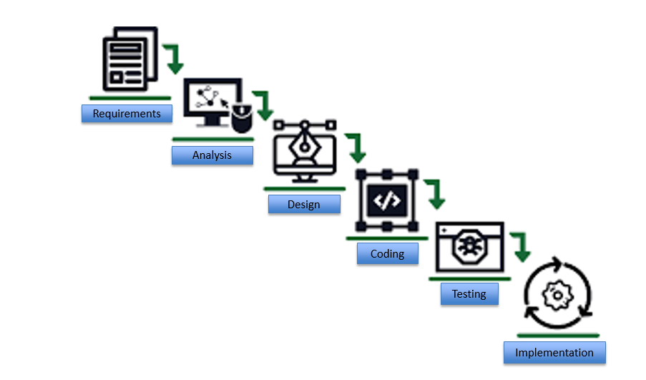

Slide 12
Classical waterfall model is an idealistic model for software development. It is very simple, so it can be considered as the basis for other software development life cycle models.
Classical waterfall model divides the life cycle into a set of phases. This model considers that one phase can be started after completion of the previous phase. That is the output of one phase will be the input to the next phase. Thus the development process can be considered as a sequential flow in the waterfall. Here the phases do not overlap with each other.

Slide 13
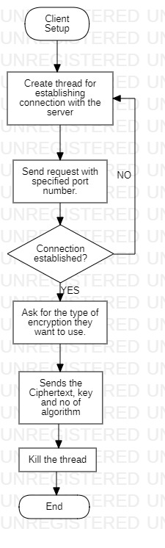
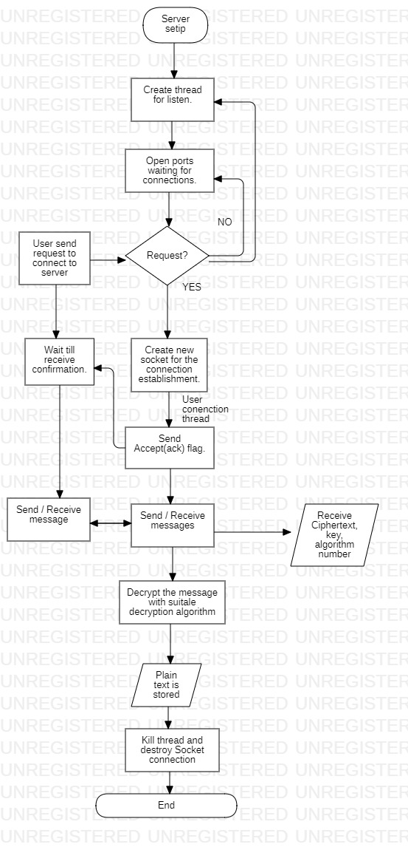
Project Flowchart

Slide 14
Socket Programming
Socket programming helps us to connect 2 nodes on a network so that they can communicate effortlessly. A socket(node) listens on a particular port at an IP, while other socket reaches out to the other to form a connection. Server forms the listener socket while client reaches out to the server.
Server
Passively waits for and responds to clients
Passive socket
Client
Initiates the communication
Must know the address and the port of the server
Active socket

Slide 15
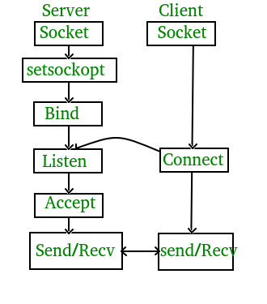
State diagram for server and client model

Slide 16
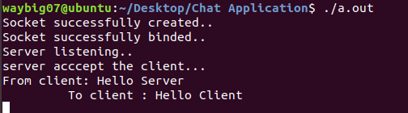
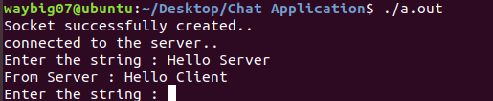
Connection Established between Server & Client

Slide 17
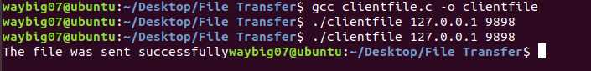
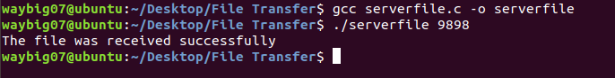
File Transfer in Socket Programming

Slide 18
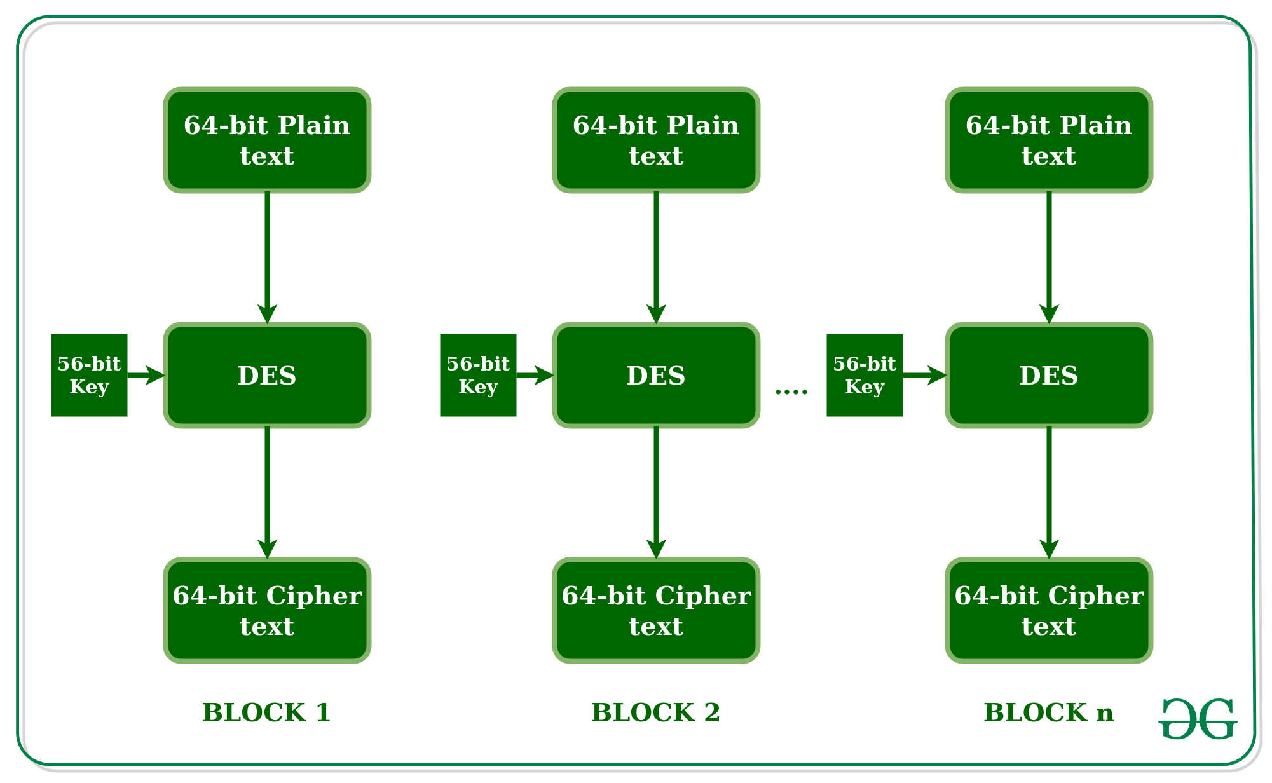
DES (Data Encryption Standard)
DES uses Symmetric System which both sender and receiver uses the same key.
It uses 64-bit of Block Encryption in which data the transposition and substitution of data is performed with the help of predefined arrays.

Slide 19
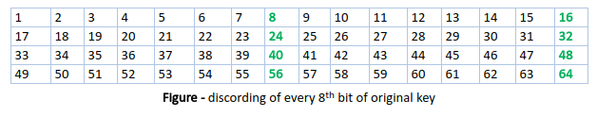
Steps for DES implementation :-
1- At first DES uses 64 bit key but every 8th bit of key is discarded and thus make it to 56 bit key.
2- Now DES works on two major principles :- Substitution and Transposition . So initially blocks of 64 bit data is handed over to initial permutation data.
3- Now IP result into two equal halves of blocks Left Plain Text(LPT) and Right Plain Text(RPT).
4- Now each LPT and RPT to go through 16 rounds of encryption process.
5- In the end, LPT and RPT are re-joined and a Final Permutation (FP) is performed on the combined block.
6- The result of this process produces 64 bit cipher text.

Slide 20
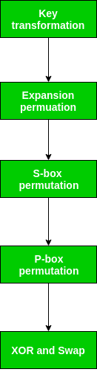
16 rounds in DES:-
Each half block consists of 32 bits, and each of the 16 rounds, in turn, consists of the broad level steps outlined :-
Key Transformation:- From 56 bit key a 48 bit key is generated by shifting bits in accordance with the shift array and the other bits are discarded.
Expansion Permutation :- It is performed on the LPT and RPT where they are expanded to 48 bit.
S-box permutation :- Makes bit permutate over 8 different types.
XOR and Swap:- Makes two blocks to convert into one 64 bit cipher text which Swap and XOR operations.

Slide 21
RSA Algorithm
RSA algorithm is asymmetric cryptography algorithm. Asymmetric actually means that it works on two different keys i.e. Public Key and Private Key. As the name describes that the Public Key is given to everyone and Private key is kept private.
The idea of RSA is based on the fact that it is difficult to factorize a large integer. The public key consists of two numbers where one number is multiplication of two large prime numbers. And private key is also derived from the same two prime numbers.
So if somebody can factorize the large number, the private key is compromised. Therefore encryption strength totally lies on the key size and if we double or triple the key size, the strength of encryption increases exponentially. RSA keys can be typically 1024 or 2048 bits long.

Slide 22
RSA Algorithm:
a) Key Generation :
Select p,q…….. p and q both are the prime numbers, p≠q.
Calculate n=p × q
Calculate q(n) = (p-1) (q-1)
Select integer….g(d ( (n), e)) =1 & 1< e < (n)
Calculate d; d= e-1 mod (n)
Public Key, PU= {e, n}
Private Key, PR ={d,n}
b) Encryption :
Plaintext : m<n< p="">
Ciphertext: C
c) Decryption:
Ciphertext: C
Plaintext : M= Cd mod n
Note 1 : (n) -> Euler’s totient function
Note 2: Relationship between C and d is expressed as:
ed (mod (n))=1
ed = 1 mod (n)
d = e−1e−1 mod (n)

Slide 23
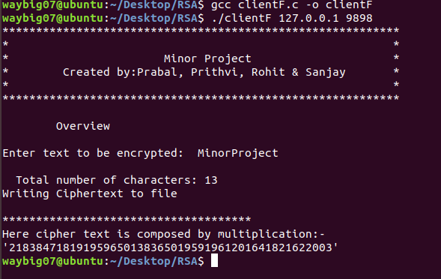
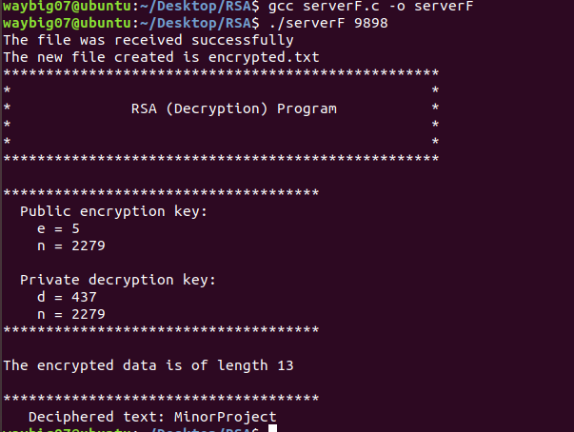
Socket Programming in RSA Algorithm
Client Side
Server Side

Slide 24
System Requirements
Hardware requirements:
One personal computer with:
Minimum 4 gigabytes of RAM
2Ghz Processor
Programming Language used:- C
Software requirements:
Linux Operating System
GCC compiler.

Slide 25
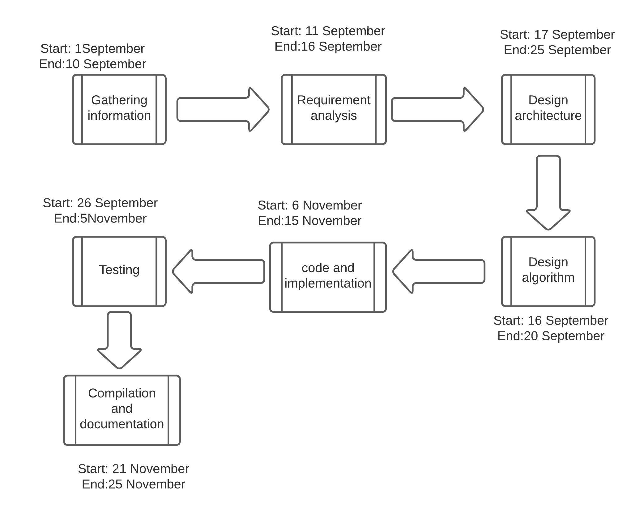
Pert Chart

Slide 26
Refrences
•https://www.google.co.in/search?q=socket+prgramimg&oq=socket+prgramimg
•
•https://c-program-example.com/2012/04/c-program-to-encrypt-and-decrypt-a-password.html
•
•https://randomnerdtutorials.com/how-to-make-two-esp8266-talk/
•
• https://documentation.progress.com/output/ua/OpenEdge_latest/gscsv/encryption-2fdecryption-algorithms.html#:~:text=Encryption%2Fdecryption%20algorithms&text=The%20AES%20cipher%20is%20the,key%20based%20on%20a%20passphrase.
•
•https://en.wikipedia.org/wiki/Encryption
•
•https://patents.google.com/patent/US7013387B2/en
•https://www.tutorialspoint.com/cryptography/advanced_encryption_standard.htm

